Slide 1
A Systematic Review of Heart Sound Detection Algorithms: Experimental Results and Insights
Conference / Journal: IEEE Transactions on Instrumentation and Measurement (2025)

Slide 2
Motivation & Problem
Heart sounds (PCG) are important for early cardiovascular disease screening.
Automatic detection/classification of heart sounds can enable scalable screening.
Challenges: noise, heterogeneous datasets, variable sampling rates, and segmentation difficulty.

Slide 3
Paper Goals
Provide a systematic review of heart sound detection algorithms.
Propose a standard experimental pipeline (preprocessing → segmentation → features → classification → evaluation).
Re-evaluate algorithms on common datasets using the same protocol to draw fair comparisons.
Offer practical insights and recommendations for future work.

Slide 4
Datasets Used
Multiple public PCG datasets considered (heterogeneous sampling rates and populations).
Example sampling rates:
PHSD: 44.1 kHz (high-quality audio)
PHSCCD: reported below ~195 Hz for some recordings
PCCD: 2000 (resampled)
Authors resample datasets to a common sampling frequency (commonly 1000–2000 Hz) for experiments.

Slide 5
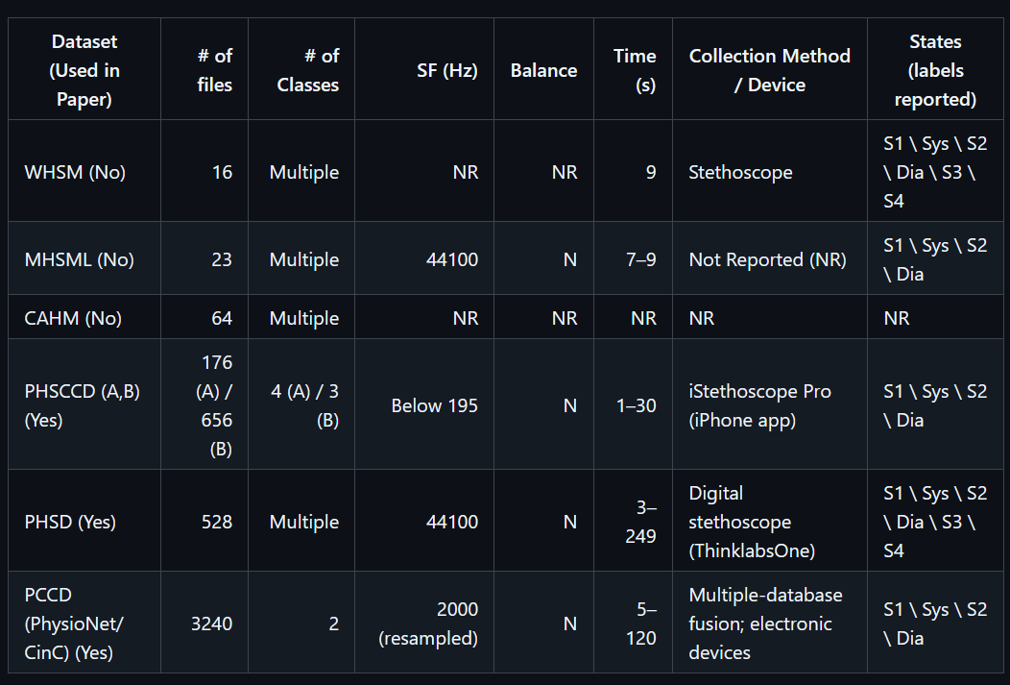
Datasets Used

Slide 6
Detailed Standard Process (pipeline)
Resample to a common fs (1000–2000 Hz recommended)
Denoise / Filtering (bandpass, wavelet methods)
Segmentation (S1, systole, S2, diastole) — optional for DL
Feature extraction (time-domain, time-frequency, multifeature)
Classification (traditional ML and deep learning)
Evaluation (subject-wise splits, metrics)

Slide 7
Preprocessing: Resampling & Denoising
Resample: unify sampling rates (e.g., 1000–2000 Hz) — meets Nyquist for heart-sound bandwidth (~800 Hz).
Denoising: typical approaches mentioned in paper:
Butterworth bandpass filter
Chebyshev filter
Wavelet thresholding
Wiener spectral subtraction

Slide 8
Segmentation
Heart cycle states: S1, systole, S2, diastole.
Accurate S1/S2 localization is crucial when extracting region-specific features.
Traditional methods for exact segmentation are feature‑based (WT, Hilbert envelope, Shannon energy, fractal decomposition).
Deep learning often uses equal-length slices (no exact segmentation) and still achieves strong performance.

Slide 9
Feature Extraction
SIV (single variable / time-domain): peaks, energy, intervals, std, entropy.
DIV (time-frequency): STFT spectrograms, MFCCs, wavelet transforms (CWT/DWT), S-transform, WPD.
Multifeature: combine many features (often used with classical ML).
Others: LBP/LTP, spectral purity index, learned features (DNNs).

Slide 10
Classification Approaches
Classical ML: SVM, k-NN, Random Forests, small ANNs, ANFIS — operate on handcrafted features.
Deep learning: CNNs (2D on spectrograms), 1D CNNs on waveforms, RNN/LSTM variants.
Transfer learning: fine-tune ImageNet CNNs (VGG, ResNet) on spectrogram images.
Ensembles and multifeature fusion remain popular for robustness.

Slide 11
Models Mentioned
VGG16 (VGG family): classic CNN for images; used on spectrograms.
ResNet18: CNN with residual connections, easier to train in deeper nets.
Rsnet: authors' variant (paper uses a model labeled “Rsnet” — a ResNet-like model or tuned variant).
All three are deep learning models used in classification experiments.

Slide 12
Experimental Setup
Equal-length slice experiments: vary slice length (e.g., 0.25–1.5 s) and overlap rate (0–80%).
Inputs: spectrograms / wavelet images / extracted features / raw waveform.
Validation: subject-wise splits recommended to prevent leakage.
Metrics: Accuracy, Sensitivity, Specificity, Precision, F1-score, AUC

Slide 13
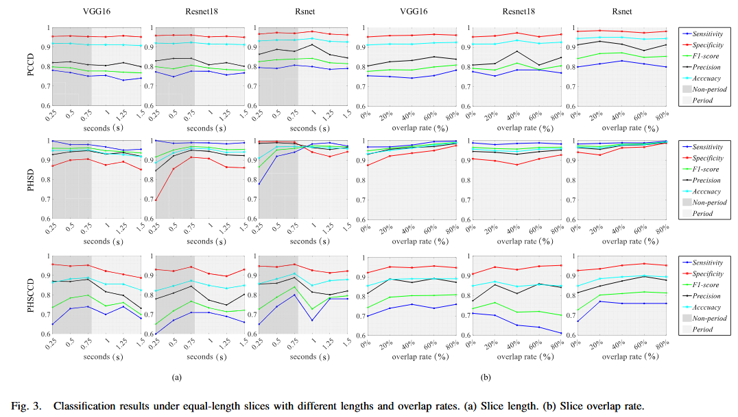
Classification Results
Key takeaways: Rsnet tends to yield the best and most consistent Accuracy and F1.
PHSD dataset shows near-top performance with best models.
Slice length ≈ 1.0–1.25 s and higher overlap rates (40–80%) are generally favorable.

Slide 14
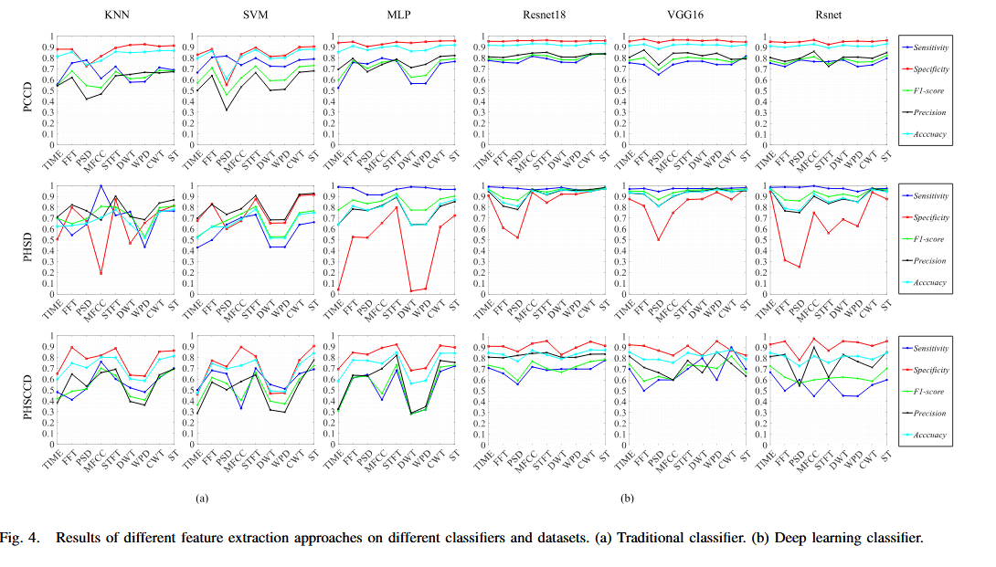
Feature‑Extraction Comparison
Fig. 4 compares many feature extraction methods across classifiers and datasets.
Layout:
Rows = datasets (PCCD, PHSD, PHSCCD).
Columns = classifiers (traditional on left; deep on right).
X-axis labels are feature types: TIME, FFT, PSD, MFCC, ST, DWT, WPD, CWT, ST (S-transform) etc.
Curves: Sensitivity (blue), Specificity (red), F1 (green), Precision (black), Accuracy (cyan).

Slide 15
Traditional Classifiers (KNN / SVM / MLP)
Visual summary (traditional):
Time-domain (TIME) alone is often OK but inconsistent across datasets.
MFCC and PSD variants frequently give stable and high Specificity and Accuracy for traditional classifiers.
Wavelet features (DWT, CWT, WPD) show variable performance but can boost Sensitivity/F1 on noisy datasets.
Best practice (traditional): combine MFCC + PSD + selected wavelet subbands (multifeature) and use feature selection.

Slide 16
Deep Learning Classifiers (ResNet18 / VGG16 / Rsnet)
Visual summary (deep models):
Deep models perform best with time‑frequency images: STFT spectrograms, CWT scalograms, and MFCCs treated as 2D.
CWT and ST often give higher F1 and Accuracy (and more stable Sensitivity) for deep models, compared to simple TIME features.
Rsnet and ResNet18 show particularly strong and stable Accuracy/F1 using DIV features (ST, CWT).
Best practice (DL): feed spectrogram/CWT images to CNNs (or use transfer learning on pre-trained image CNNs).

Slide 17
Practical takeaway from Fig. 4
If using classical ML: engineer MFCC + PSD + wavelet features and perform feature selection.
If using DL: prefer spectrogram/CWT/MFCC image inputs for CNNs (ResNet/VGG variants).
Combine approaches: use segmentation‑aware time/interval features for interpretability alongside DL on spectrograms for performance.
Always validate subject‑wise; feature gains can be dataset-specific.

Slide 18
Practical Recommendations
Standardize preprocessing across datasets (resample + denoise) before comparison.
Use subject-wise validation to obtain realistic performance estimates.
If data is abundant: prefer DL on time-frequency images (spectrogram/CWT).
If limited labels: use engineered multifeature + classical ML, data augmentation, or transfer learning.
Maintain region-aware analysis (S1/S2) for clinical interpretability.

Slide 19
Limitations Noted by Authors
Dataset heterogeneity: device differences, recording conditions, age groups hinder generalization.
Some literature reports optimistic performance due to improper splitting or leakage.
Need for larger, diverse, well-annotated datasets and standardized benchmarks.

Slide 20
Future Work Directions
Build larger multi-center datasets annotated by clinicians.
Develop models robust to noise and device variability.
Combine segmentation-aware clinical features with DL feature learning.
Explore explainability to increase clinical trust.

Slide 21
Summary & Takeaway
A consistent experimental pipeline is critical for fair comparison.
Resampling + denoising + subject-wise eval = minimal standard practice.
Deep CNNs on spectrogram/CWT/MFCC images give the best overall performance when sufficient data is available.
For clinical adoption: focus on robustness, interpretability, and standardized datasets.

Slide 22
Thank You
Questions?

